Slide 1

Linear vs. Non-Linear Alpha
A Liquidity-Aware Comparison of LSTM and Ridge Signals Across Equal-Weighted and Market-Cap-Weighted Portfolios
Presented by Dongtong Zhong / Feifan Gu / Liwen Dai

Slide 2

Why Non-Linear Modeling?
•
The Limitation: Traditional linear models (CAPM, Fama-French) assume static, additive relationships between factors and returns.
•
The Reality: Markets are complex adaptive systems with low signal-to-noise ratios and non-stationary dynamics.
•
The Solution: LSTM (Long Short-Term Memory) networks process sequential data, capturing temporal dependencies and path-dependent patterns (e.g., volatility decay) invisible to linear benchmarks.

Slide 3
Data Source & Sample Selection
Universe Constraints
Training (In-Sample): 2005-01 to 2018-12
•
•
Source: CRSP Monthly Stock File & Daily Data.
•
Validation: 2019-01 to 2022-01
•
Assets: Ordinary Common Shares (Codes 10, 11) on NYSE, AMEX, NASDAQ.
•
Testing (Out-of-Sample): 2022-01 to 2025-1
Time Horizon: Jan 2005 – Jan 2025.
•
Strict Alignment: Unified Evaluation Start Date (Jan 31, 2022)
•

Slide 4

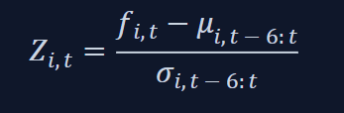
Feature Engineering & Normalization
Rolling Z-Score Normalization
Stock-Level Features
Momentum: Short-Term (3m) and Long-Term (12m) geometric cumulative returns.
To mitigate non-stationarity, features are standardized using a rolling 6-month window:
•
•
Volatility: Annualized standard deviation (6m rolling).
•
Dynamics: Log changes in price and volume
•
Liquidity: Corwin-Schultz Spread proxy.
This preserves local signal patterns while removing long-term trends.

Slide 5

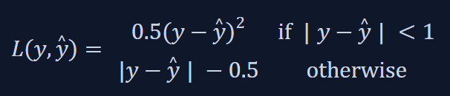
Model Architecture: LSTM
Network Specification
Input: Sequence tensor (B, L, F), where B is batch size(512), L is lookback window(6, 12, 24), F is the number of features.
Objective Function: Huber Loss
•
Robust to "fat-tailed" financial noise:
•
Layers: 2 stacked LSTM layers (32 units) with 0.1 Dropout.
•
Head: MLP with Layer Normalization and ReLU.
•
Optimizer: AdamW (Learning Rate 10^(-3), weight decay 10^(-4)).

Slide 6
Model Architecture: Linear Benchmark
•
Model Type: Ridge Regression (linear baseline)
•
Input: Historical window flattened into a single static vector of size (L⋅F)
•
Usage: Measures how much predictive value comes purely from non-linear + sequential modeling

Slide 7
Predictive Performance (Out-of-Sample)
Model | Lookback (L) | MSE (Lower is Better) | Hit Rate (Higher is Better) | Signal Stability
LSTM | 24 Months | 0.0276 | 48.9% | Medium
LSTM | 12 Months | 0.0393 | 48.5% | Medium
LSTM | 6 Months | 0.0303 | 49.9% | Medium
Linear (Ridge) | 24 Months | 0.0324 | 49.1% | Medium
Linear (Ridge) | 12 Months | 0.0328 | 48.2% | Medium
Linear (Ridge) | 6 Months | 0.0295 | 48.6% | Medium

Slide 8



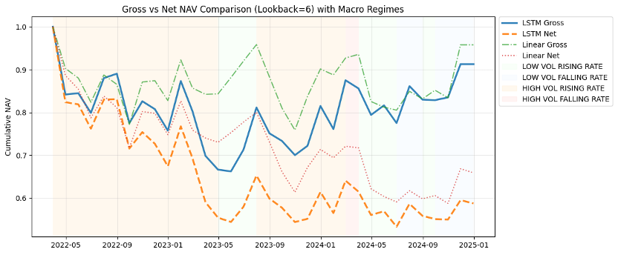
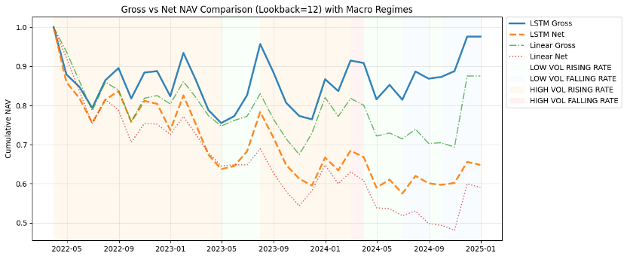
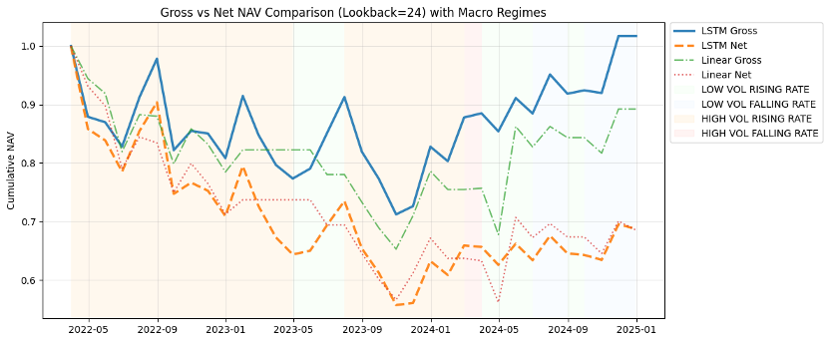
Equal-Weighted Strategy Performance
L=6: Noisy Short-Horizon Signals
L=12: The Cost Trap
L=24: Structural Cost Failure
The 6-month LSTM produced unstable short-horizon signals that led to a –17.5% Net Annualized Return and a –46.7% drawdown, as constant rebalancing into small-cap stocks created severe bid–ask losses.
The Linear model showed slightly smoother behavior but still delivered a –14.0% Net Return, confirming that under equal weighting, transaction costs dominate both models.
Extending the window to 12 months improved stability but not profitability.
The LSTM achieved –0.9% Gross yet –14.6% Net Return, revealing that EW’s heavy turnover into illiquid names overwhelms any signal improvement.
The Linear model performed worst, with a –17.4% Net Return and the lowest Sharpe, showing linear signals cannot offset EW’s structural cost burden.
The 24-month LSTM generated 0.6% Gross Return, but costs pushed Net to –12.7%, showing that EW’s wide small-cap exposure makes long-horizon nonlinear signals impractical to trade.
The Linear model fared no better (–12.8% Net), lacking the nonlinear structure needed for effective stock selection under high-cost conditions.

Slide 9
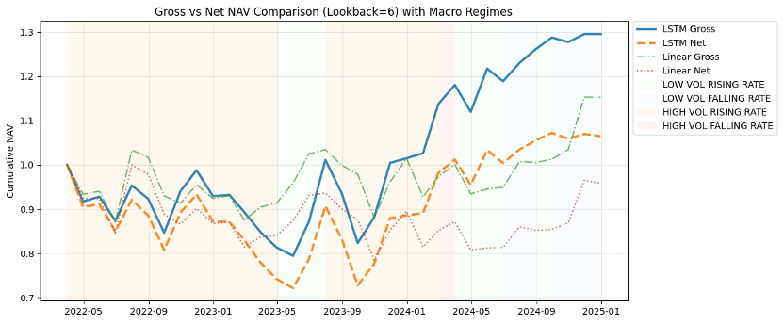
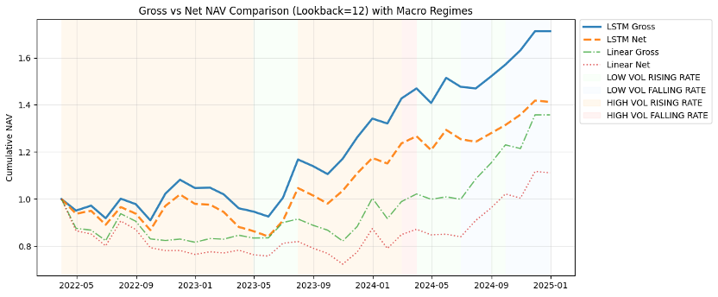
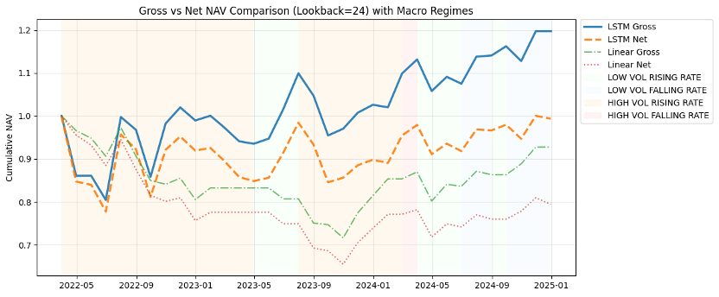
Market-Cap-Weighted Strategy Performance
L=6: Low Active Return
L=12: Peak Performance Window
L=24: Signal Dilution from Long Horizons
Market-cap weighting reduces drawdowns and limits trading costs, but the 6-month LSTM produces only mild alpha.
Gross return reaches 9.9%, yet Net performance falls to 2.3%, showing that short-horizon signals remain too noisy in large-cap markets.
The Linear model performs similarly weakly, with –1.5% Net Return, behaving more like a broad-market beta than an alpha strategy.
The 12-month window delivers the strongest overall performance.
The LSTM earns 21.6% Gross and 13.4% Net annualized return with a 0.73 Sharpe, effectively balancing trend capture and noise control. Moderate drawdowns further confirm L=12 as the most stable configuration. The Linear model improves but still lags, generating only 3.9% Net with limited ability to identify winners in an efficient large-cap market.
The LSTM generates 6.8% Gross but only –0.2% Net, indicating that long windows over-smooth important short-horizon nonlinear signals. Despite low trading costs under MCW, predictive strength weakens, producing stable but muted alpha.
The Linear model deteriorates further (–8.0% Net, Sharpe –0.51), unable to extract meaningful patterns from diluted long-horizon features.

Slide 10
Core Performance Metrics (Top 5)
Model | Weighting | Gross Ann. Ret | Net Ann. Ret | Sharpe | Sortino | Max Drawdown
LSTM (12M) | MCW | 21.6% | 13.4% | 0.732 | 1.029 | -17.5%
Linear (12M) | MCW | 11.7% | 3.9% | 0.282 | 0.339 | -27.6%
LSTM (6M) | MCW | 9.9% | 2.3% | 0.210 | 0.234 | -27.9%
LSTM (24M) | MCW | 6.8% | -0.2% | 0.108 | 0.123 | -22.3%
Linear (6M) | MCW | 5.3% | -1.5% | 0.032 | 0.033 | -21.5%

Slide 11






Regime Robustness
Best Regime
Defensive Power
Stabilizer
Low Vol + Falling Rates: The LSTM (12M, MCW) delivered its strongest performance here, capitalizing on clear momentum trends and low liquidity costs.
High Vol + Rising Rates (2022): While typical strategies crashed, the MCW LSTM restricted drawdowns to -17.5%, significantly outperforming the -27.6% drawdown of the Linear model.
MCW acts as a natural regime stabilizer, dampening shock sensitivity compared to EW portfolios which amplify macro volatility.

Slide 12
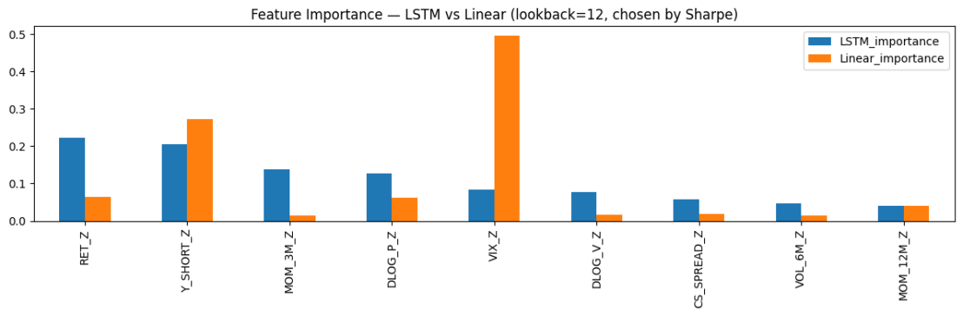
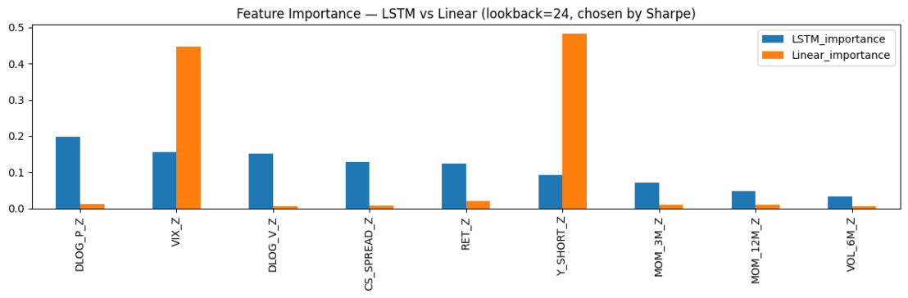
Interpretability: Feature Importance
Feature Importance under Market-Cap Weighting (MCW):
Feature Importance under Equal-Weighting (EW):

Slide 13
Interpretability: Feature Importance
•
Linear model is concentrated, mainly relying on VIX_Z and Y_SHORT_Z.
•
LSTM uses a broader mix of features: including returns, momentum, and volatility signals
•
Linear captures narrow risk-sentiment effects, while LSTM reflects multi-factor interactions
•
This broader signal usage helps explain LSTM’s stronger Sharpe performance.

Slide 14




Conclusion
The Winner
The Loser
Insight
LSTM (12M, MCW) is the superior configuration (Sharpe 0.73), offering the best balance of signal agility and noise filtering.
Equal-Weighting is not viable. Despite theoretical alpha, the structural cost burden of small-cap trading consistently leads to negative returns.
Non-linear alpha exists, but it is fragile. It requires strict liquidity controls (MCW) to transition from a statistical artifact to a realizable profit.

Slide 15
Q&A
Thank you for your time.

